Slide 1
Introduction to visual studio
Adam Yoblick
6/22/2017

Slide 2
A quick note on language
All the content in this presentation is based on the C# language
Many of the concepts presented are valid for other languages as well

Slide 3
Summary
What is Visual Studio?
Why use Visual Studio?
Solution and Project files
Tour of Visual Studio
Intellisense
Building
Debugging
Keyboard shortcuts

Slide 4
What is visual studio?
Integration Development Environment (IDE) owned by Microsoft
Used to build programs for various platforms in various languages
Has many very useful built-in features
Intellisense, code navigation, refactoring, unit testing and code coverage, profiling, cloud integration, version control integration, etc…

Slide 5
Why use visual studio?
Because you’re at Microsoft =)
Also, because it’s probably the most powerful IDE there is

Slide 6
Solution files
Main container for Visual Studio projects
Identified by .sln extension
Contain paths to at least one project file, as well as some solution metadata
Solutions are really just containers for projects

Slide 7
Project files
Main container for source code
Identified by .csproj extension
Contain many things, including paths to source files, external references, and lots of project settings and metadata
Projects usually contain source code and compile into binaries
.exe, .dll, etc…

Slide 8
Creating a solution and project
Open Visual Studio
Click on File -> New -> Project
In the left pane, select Visual C#
In the right pane, select Console Application
Name both your project and solution
Make sure “Create directory for solution” is checked
Click on OK
Congratulations, you have a new solution with one project!

Slide 9
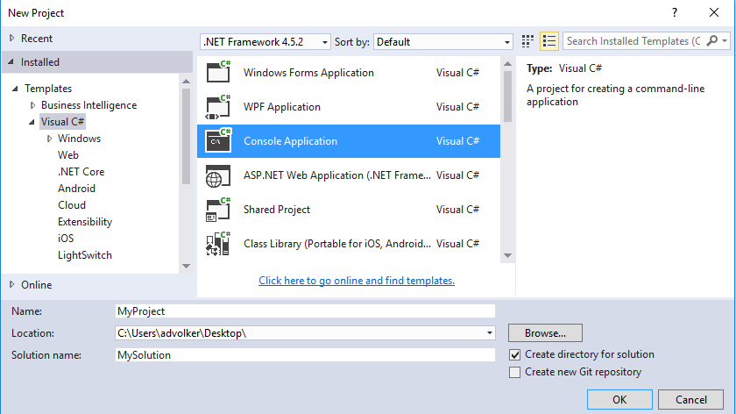
Creating a new solution and project

Slide 10

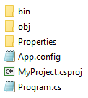
Creating a new solution and project
The solution directory will contain a solution file as well as a folder containing the single project
The project directory will contain a project file, some source code, metadata used by the project file, and output directories

Slide 11
Tour of Visual Studio
Visual Studio contains many menus and windows
It’s easy to get lost or be overwhelmed
This tour will cover the most commonly used areas so you can get started quickly

Slide 12
Note on Visual Studio UI
Note that the Visual Studio UI is very customizable
Everything can be moved, docked, added to tabs, and closed
This presentation will assume default positions for everything
If you can’t find a specific window, use the View menu
It contains shortcuts to nearly all the windows you need
You can also use Debug -> Windows and Test -> Windows

Slide 13
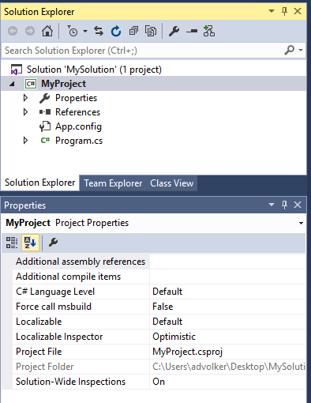
The right pane
The top right pane contains three tabs by default:
Solution Explorer
Team Explorer
Class View
The bottom right pane contains the properties window
The following slides will cover these in detail

Slide 14
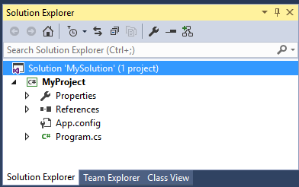
Solution explorer
Displays all projects in the solution
Displays all files in each project, as well as some project metadata

Slide 15
Common Solution Explorer actions
Opening source files
Adding/removing project items
Adding/removing projects
Viewing/adding/removing references
Open folder in file explorer
Sync with active document
Collapse all

Slide 16
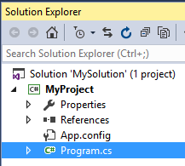
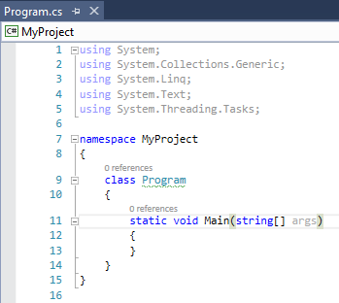
Opening source files
To open a source file, just double click on it
This will open the file (in a new tab) in the text editor in the top left pane

Slide 17
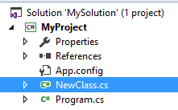

Adding project items
Right click on the project name
Click on Add
Click on New Item or Existing Item
If new, select the item type (usually Class) and give it a name
If existing, browse to the file you want to add
Your added file will appear in the Solution Explorer and will be opened in the left pane

Slide 18
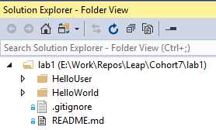
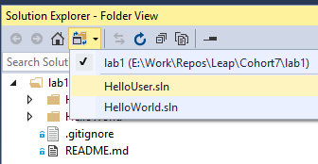
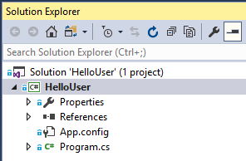
Adding project items
Make sure you are not in “folder view” when adding new items, or they will not get added to the project

Slide 19
Removing project items
To completely delete an item from your computer, right click on the item and click on Delete
To remove an item from the project without deleting it, right click on the item and click on Exclude from Project

Slide 20
Adding projects
To add a project to your solution, right click on the solution and click on Add
You can create a new project or add an existing project

Slide 21
Removing projects
To remove a project from a solution, right click on the project and click on Remove
You can also unload a project, which keeps the project in the solution but prevents it from being compiled
To do this, right click on the project and click on Unload Project

Slide 22
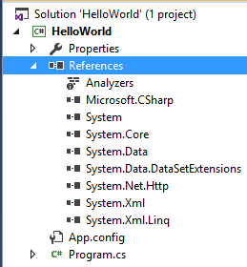
Viewing references
A project can reference other projects in the solution
It can also reference files outside the solution
This is useful when you need to use code that you did not write
To view references, expand the project, and expand references

Slide 23
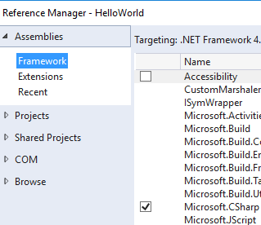

Adding references
Right click on References and click on Add Reference…
Click on Assemblies -> Framework to browse the .NET Framework
Use Search Assemblies in the upper right to filter
Click on Browse to specify the full path to a file to reference
Click on Projects to reference another project in your solution

Slide 24
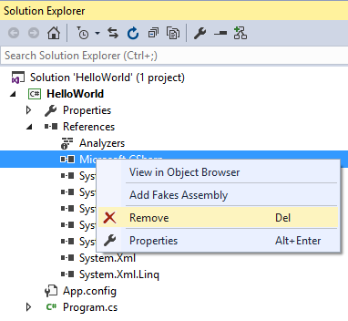
Removing references
Right click on a reference and click on Remove

Slide 25
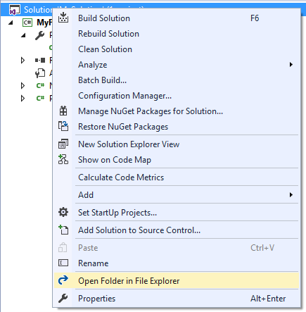
Open folder in file explorer
Sometimes it’s useful to open items from the Solution
Explorer in the normal Windows file explorer
You can easily do this by right clicking on any
solution, project, or folder, and clicking on
Open Folder in File Explorer

Slide 26
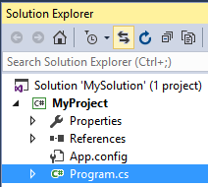
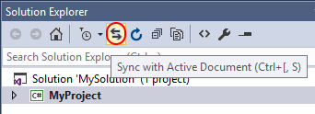
Sync with active document
Sometimes you have a file open in the text editor, but you don’t know where it is in the solution explorer
This can happen easily when you have multiple projects with hundreds of files
To navigate directly to the file, click on the Sync with Active Document icon

Slide 27
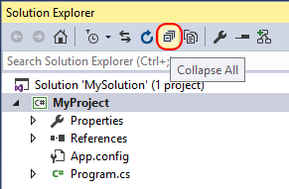
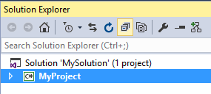
Collapse all
The first time you open a solution in Visual Studio, the projects are often full expanded
This can be difficult to navigate when there are lots of projects, each containing lots of files
To collapse all projects at once, click on the Collapse All icon

Slide 28
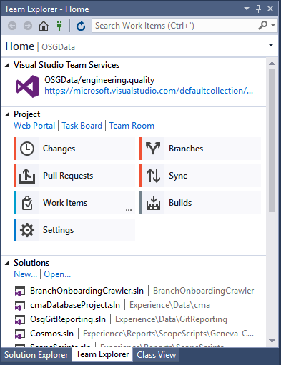
Team explorer
Contains common operations for Visual Studio Team
Services (VSTS), Team Foundation Server (TFS),
and Version Control (Git)
This is covered in more detail in the “Version Control
using Git” and “Agile and Task Management using
VSTS” presentations

Slide 29
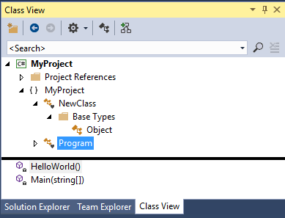
Class view
Tree view of all projects, namespaces, classes, and functions in the solution
I’ve literally never used this in my life

Slide 30
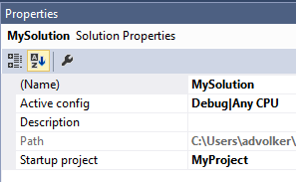
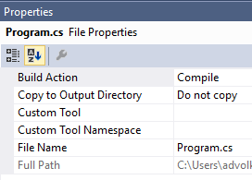
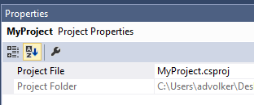
The properties window
The properties window is in the lower right pane
The contents are context sensitive, depending on what you have selected in the Solution Explorer

Slide 31
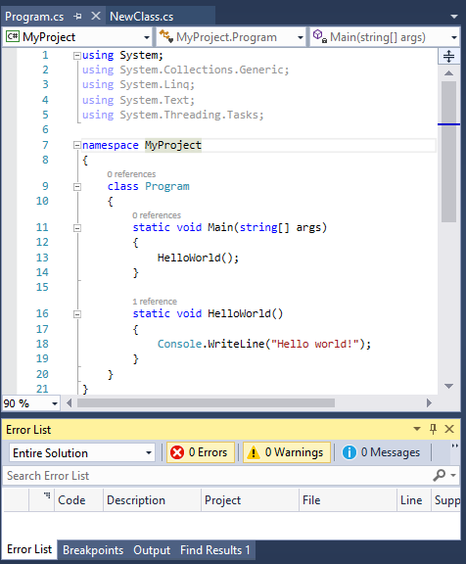
The left pane
The top left pane contains the text editor
The bottom left pane contains various useful tabs, such as:
Error List (will be covered during “Compiling”)
Breakpoints (will be covered during “Debugging”)
Output
Find Results
The following slides will cover these in detail

Slide 32
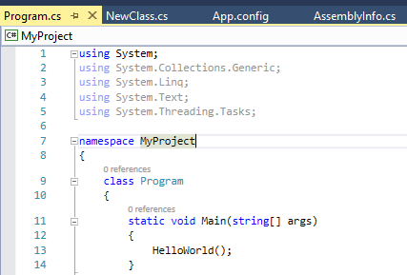
The text editor
The text editor is where you write all your code
It contains tabs at the top so you can keep multiple files open at once

Slide 33
Text editor common operations
Navigate forwards/backwards
Comment/uncomment selected
Browsing functions in class
Collapsing functions
Vertical tab groups
Two windows, same file
Searching
Show line numbers
Go to line number
Go to definition/implementation
Find all references

Slide 34
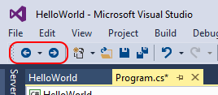
Navigate forwards/backwards
Visual Studio remembers what files you had open, and what line you were working on
It’s easy to get lost with lots of files
Use the “Navigate forwards/backwards” icons to go back/forward to where you were
These behave similar to web browser “back/forward” buttons

Slide 35
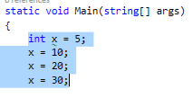
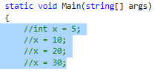
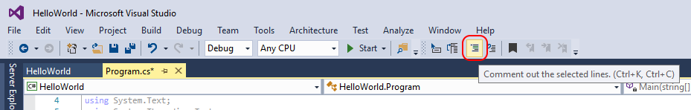
Comment selected
To quickly comment out an entire block of code, highlight the code and click on the “Comment out the selected lines” icon

Slide 36
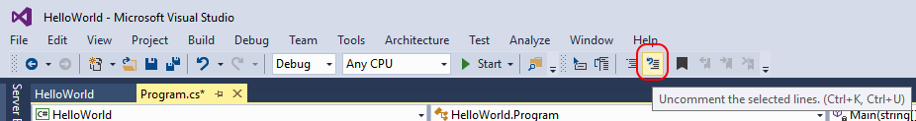
Uncomment selected
To quickly uncomment out an entire block of code, highlight the code and click on the “Uncomment the selected lines” icon

Slide 37
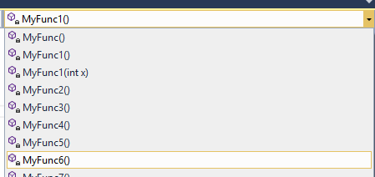
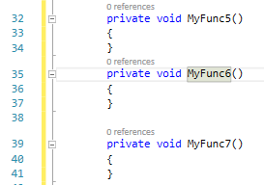
Browsing functions in class
Use the upper right dropdown to browse all functions in the current class
Very useful for classes with lots of functions or functions with the same name
Selecting a function will navigate to it in the text editor

Slide 38
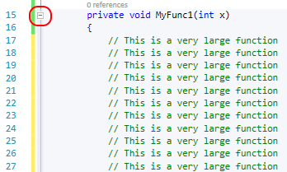

Collapsing functions
Use the “-” icon to the left of function names to collapse the function to a single line
Useful for very large functions or functions you’re not working on

Slide 39
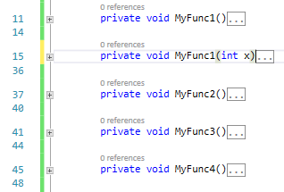
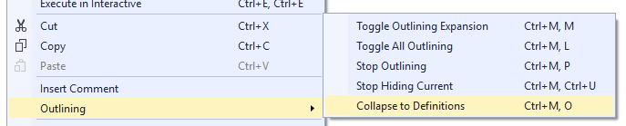
Collapsing all functions
Sometimes a class has lots of functions and you want to collapse them all
To do this, right-click anywhere in the file, and click on Outlining -> Collapse to Definitions

Slide 40
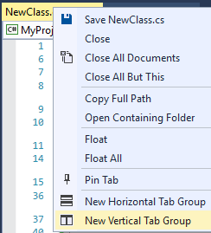
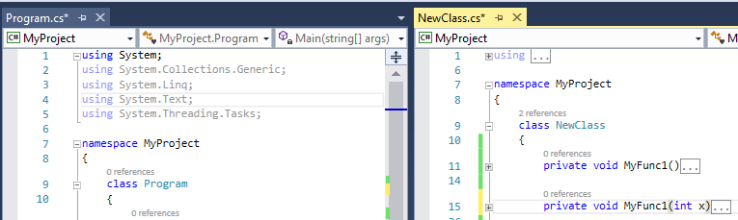
Vertical tab groups
Sometimes it’s useful to open two files at once, side-by-side
To do this, right click on a filename tab and click on New Vertical Tab Group

Slide 41
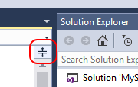
Two windows, same file
Sometimes, it’s useful to have two windows showing the same file
Especially if the file is very large
This allows you to read/modify a file in two places at once
To do this, click and drag down the icon above the right scrollbar

Slide 42
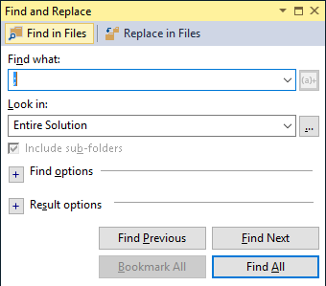
Searching
The most powerful way to search in Visual Studio is with ctrl + shift + F
You can specify many inputs, such as:
What to find
Where to look
What file extensions to search
Etc…

Slide 43
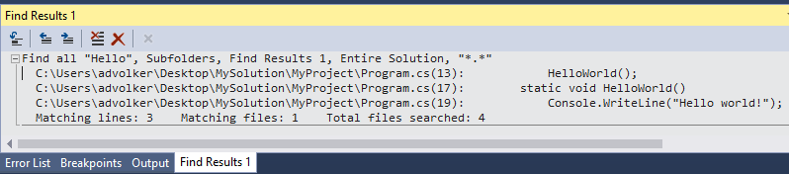
Searching
By default, all find results will appear in the “Find Results 1” tab in the bottom left pane

Slide 44
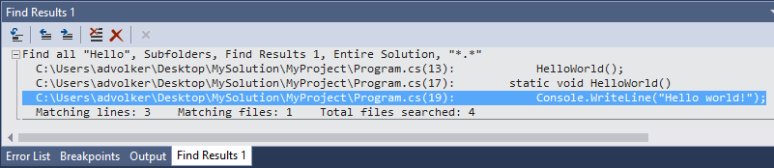

Searching
Double clicking on a line in the Find Results window will navigate directly to that line in the text editor

Slide 45
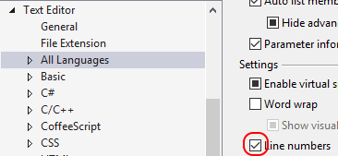
Show line numbers
Line numbers are not shown on all file types, by default
To fix this, go to Tools -> Options
Scroll down and expand Text Editor
Click on All Languages
Make sure Line Numbers is checked
Click on OK

Slide 46
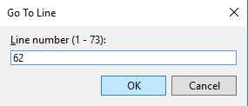

Go to line number
Sometimes you have a line number and you want to quickly navigate to that line
Happens a lot when viewing build error logs, etc…
To do this, use ctrl + G and enter the line number, then hit enter

Slide 47


Go to definition / implementation
Sometimes you want to examine what a function does, but all you have is a call to that function
Right click on the function name and click on Go To Definition (F12)
Use Go To Implementation if the function is on an interface (ctrl + F12)
This will navigate directly to the function definition

Slide 48
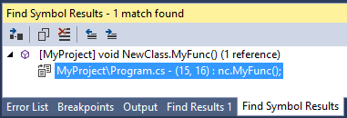
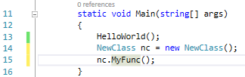

Find all references
Sometimes you want to find all references to a function
For example, you want to see all the code that calls it
Right click on the function call OR the function definition and click on Find All References
The results will show up in the Find Symbol Results window in the bottom left pane
Double click on the line to navigate directly to that reference

Slide 49
Intellisense
Intellisense is a set of features designed to help developers write code more efficiently
It includes:
List members
Quick info
Parameter Info

Slide 50
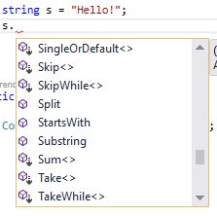
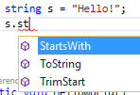
Intellisense – list members
A list of valid members from a type appears when you
type a period (.) after the type
Typing more will filter the list down to matches
Once the correct item is highlighted, you can auto-complete using tab
You can also use space, enter, or “(“ if you are calling a function

Slide 51

Intellisense – quick info
Quick info displays the complete declaration for any identifier in your code
You can use the up and down arrows on the keyboard to browse through all the matches

Slide 52

Intellisense – parameter info
Parameter info gives you information about the number, names, and types of parameters required by a function
The parameter in bold represents the next parameter required, as you type

Slide 53
Building
I’m not going to explain exactly what happens when you build a solution
That will be covered when we talk about compiling in another presentation
I WILL show you how to build so you can run your code

Slide 54
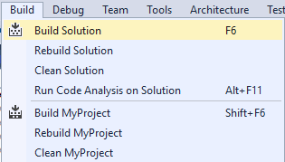
Building
To build the solution, click on the Build menu and click on Build Solution
You can also hit F6 on the keyboard
You can also clean (deletes old outputs) and rebuild (clean + build)
You can also build just the current project

Slide 55
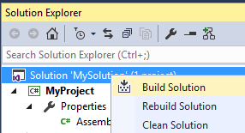
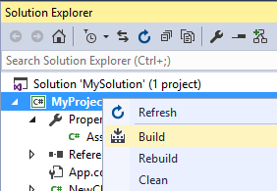
Building
You can also build directly from the solution explorer
Right click on the solution (or a project) and click on Build

Slide 56

The output tab
When building, you can see the progress by clicking on the Output tab in the lower left pane
Make sure that “Build” is selected in the “Show output from” dropdown

Slide 57

The error list tab
This tab shows all build errors and warnings, and what projects, files, and lines they appear in
It is updated constantly, even before you build
Double click on any error/warning to navigate directly to it

Slide 58


The error list tab
To hide warnings from the list, click on the icon containing the warning count at the top of the tab
To show warnings, just click on the icon again

Slide 59
Debugging
To debug the solution, click on the Debug menu and click on Start Debugging
You can also hit F5 on the keyboard
Note that debugging automatically builds code if it needs to be built, so you don’t have to build before you debug

Slide 60

Startup project
When debugging, Visual Studio needs to know which
project to launch
This is called the Startup Project and is bolded in the
Solution Explorer
To set a new startup project, right click on the project
and click on Set as StartUp Project

Slide 61
Breakpoints
A breakpoint pauses code execution when it is hit
They are set on an entire line
They are hit before the line is executed
Breakpoints are saved on your local machine, not in source control
Feel free to go crazy, don’t worry about cleaning them up

Slide 62

Setting breakpoints
To set a breakpoint, click on the grey column to the left of the line number on the line you want to break on
You’ll see a red circle appear when it’s set
You can also use F9 on the keyboard
To remove a breakpoint, just click on it again

Slide 63


Disabling breakpoints
A disabled breakpoint is still there, but will not stop code execution
Useful for temporarily “turning off” a breakpoint
To do this, right click the breakpoint and click on Disable Breakpoint
You’ll see the red filled circle change to a red empty circle

Slide 64

Conditional breakpoints
Suppose you only want to break when a condition is met
Useful when looping through something or when trying to repro a bug
Right click on the breakpoint and click on Conditions…
A window will pop up with various conditions you can set
The breakpoint will only hit when the conditions are met

Slide 65

Breakpoints tab
You can also interact with breakpoints from the Breakpoints tab in the lower left pane
If you don’t see it, click on Debug -> Windows -> Breakpoints
This tab shows all breakpoints across the entire solution
Double click on a breakpoint to navigate directly to it in the text editor

Slide 66


When breakpoints are hit
When a breakpoint gets hit, several things happen:
The text editor automatically navigates directly to the breakpoint
A yellow arrow appears inside the breakpoint
The entire line is highlighted in yellow

Slide 67


Examining local variables
When code execution is paused, you can examine the contents of local variables by using the Locals tab in the lower left pane
You can also do this by hovering over the variable name in the text editor

Slide 68


Watching variables
You can also add variables to the Watch tab in the lower left pane
The contents of this tab are saved between runs
To do this, just click on a line in the watch tab and type the name of the variable you want to watch
You can also highlight the variable in the text editor and drag it to the watch window

Slide 69


Watching variables
As code is executed, the values in the watch window will update
The value color will change to red when the variable value is changed

Slide 70
Controlling program execution
To Continue program execution after hitting a breakpoint, hit F5 on the keyboard, or use the continue icon at the top
To Stop program execution, hit Shift + F5, or use the stop icon at the top
To Restart the program, hit Ctrl + Shift + F5 or use the restart icon at the top

Slide 71
Stepping through a program
To step into the next statement (function call, etc…), hit F11
To step over the next statement, hit F10
This still runs the statement, but does not navigate to it in the text editor
To step out of the current function (back to the caller), hit Shift + F11
To run all statements up to a specific line, right click on the line and click on Run to Cursor (or hit Ctrl + F10)
These commands are also available in the Debug menu

Slide 72

Call stack
The call stack tab in the lower left pane shows all functions that have been called that are currently waiting to return
This will be covered in more detail in a future presentation
It shows them in the order they were called, with the most recent call on top
Double click on a line to navigate directly to it in the text editor

Slide 73
Keyboard shortcuts
For a list of keyboard shortcuts for Visual Studio 2017, see http://visualstudioshortcuts.com/2017/

Slide 74
Questions?
Tons of documentation online
Contact me at advolker@microsoft.com

